Slide 1
PROJECT PRESENTATION
SUPERVISOR: Dr. Kahonge Andrew M.
Project Title: Geo-specific Emergency Message Broadcasting Over Carrier Networks
Name: Kimeu Dominic Kiio
Reg No: P15/142580/2021
Notes:
Greet the panellists
Introductions
Project Title

Slide 2









PROBLEM STATEMENT
There is currently no near-real time solution, in Kenya, that dispenses emergency information to the general public.
Current implementations fall short when timeliness of message delivery is of concern.
International News
Local News
Social Media
Notes:
No real time solution to emergency broadcasts
Implementations fail when timeliness is of concern
Sources of info, breaking news, newspapers, social media posts and hashtags

Slide 3

Problem statement (Cont.)
A recent telephony report conducted by the Communications Authority of Kenya showed estimated that 96.6% of Kenya’s population coverage has access to 2G network.
96.6%
Total population coverage
Source: (“Communications Authority of Kenya Annual Report and Financial Statements 2020-2021,” n.d.). Pg
Notes:
CAK report showed a majority of Kenyans have access to a mobile device either directly or indirectly.
At least one per household.
96.6%
[NEXT]
Not to be confused with geographical coverage at 56.5%

Slide 4
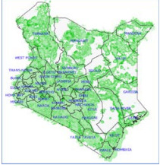
Problem statement (Cont.)
A recent telephony report conducted by the Communications Authority of Kenya showed estimated that 96.6% of Kenya’s population coverage has access to 2G network. [Heatmap??]
96.6%
56.5%
Total population coverage
Total geographic coverage
Source: (“Communications Authority of Kenya Annual Report and Financial Statements 2020-2021,” n.d.). Pg

Slide 5
Problem statement (Cont.)
A recent telephony report conducted by the Communications Authority of Kenya showed estimated that 96.6% of Kenya’s population coverage has access to 2G network.
The mobile phone has become an appendage of the average person in modern day society.
Why isn’t there a solution that leverages this known fact?
Source: (“Communications Authority of Kenya Annual Report and Financial Statements 2020-2021,” n.d.). Pg
Notes:
Why isn’t this information being leveraged to achieve near real time message broadcasting?

Slide 6
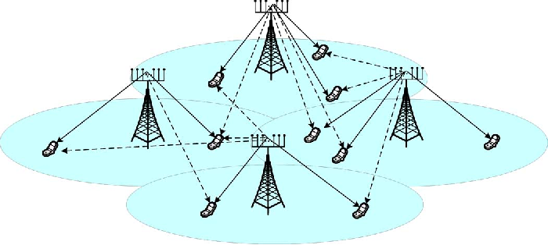
SMS-Cell Broadcasting (SMS-CB)
Geotargeted and Geofenced message broadcasting service.
One to many not peer to peer (SMS-PP)
A Cell Broadcast message is an unconfirmed push service
[Base station], [Cell which clients connect to]
Message broadcast over a Cell, Base station, or a defined area
Maintains client anonymity
Repeats the message indefinitely or for a set time
Good performance when other means of communication are congested.
Current peak performance is 1M cells within 10s
Notes:
Geofenced and geotargeted
Not p2p, one to many
Unconfirmed push service
It comes with several advantages
Access to information this quick could potentially save lives or perform quick damage control in such an area. The simulation will allow for different cell broadcast configurations such as geographical areas and select recipients (using filters) and message priorities.
I sought to create an emulation of the above
Due to the proprietary nature of the software and lack-of access to proprietary hardware, I chose to emulate the software
As a proof of concept

Slide 7
Project Objectives
Broadcasters
Define Base Stations
Define Cells
Set broadcast area and range
Define regular Zones
View Records
Mobile clients
Receive Message Broadcasts
Manage Received Broadcasts
Notes:
Two views

Slide 8




EMULATION of sms-cb
CLIENT-SERVER ARCHITECTURE

Slide 9




EMULATION of sms-cb
SERVER ARCHITECTURE
{
Compute Module

Slide 10
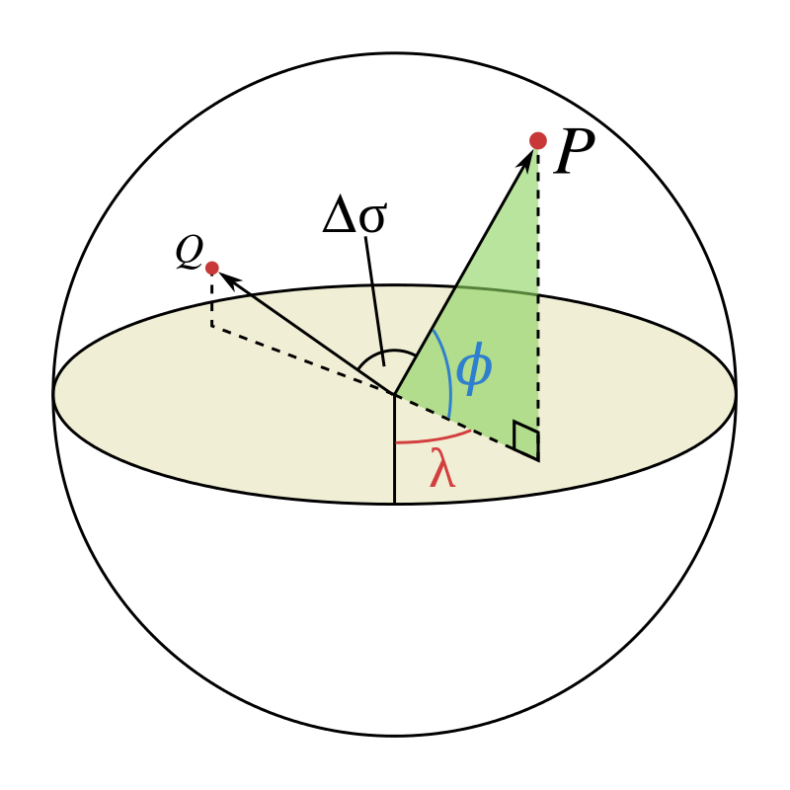
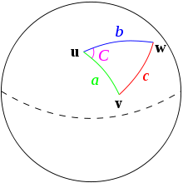
EMULATION of sms-cb
SERVER ARCHITECTURE
{
{
Compute Module
D_{H} (coord1, coord2) = 2 ⋅ sin⁻¹($\sqrt{\text{sin}{\text{(}\frac{\text{lat}\text{2−}\text{lat}\text{1}}{2}\text{)}}^{2}\text{+}\text{sin}{\text{(}\frac{\text{l}\text{ng}\text{2−}\text{l}\text{ng}\text{1}}{2}\text{)}}^{2}\text{⋅}\text{cos}\text{(}\text{lat}\text{1)⋅}\text{cos}\text{(}\text{lat}\text{2)}}$)⋅μE

Slide 11



EMULATION of sms-cb
WEB BROADCAST ARCHITECTURE
}
{
Compute Module

Slide 12


EMULATION of sms-cb
WEB BROADCAST ARCHITECTURE
}
{
Compute Module
Google Maps Js API To Visualize Broadcasts Maps and Areas

Slide 13


EMULATION of sms-cb
WEB BROADCAST ARCHITECTURE
}
{
Compute Module
{

Slide 14

Broadcaster view
Enter The necessary data (clients, base stations, broadcast zones and messages)
Single Entry
CSV interface
View Records of previous messages
Generate Reports
Define Broadcast zones and message payloads

Slide 15
Client View
An activity pane
Shows the most recently sent broadcast message sent to a client within range
* In range of a broadcast radius
* In range of its base-station’s cell

Slide 16
System Demo

